Slide 1

Weekly meeting
Date: 23 July 2025
Time: 10h00

Slide 2

Greeting
Sales & Marketing – WL, AH, DWF
Projects & Development – AH, LT ,AN, BW, AK, YN
IT Support – WL, LT, AK,AH
Policies & Procedures - QA
Q&A
AGENDA

Slide 3

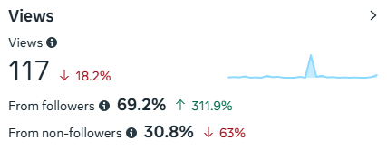
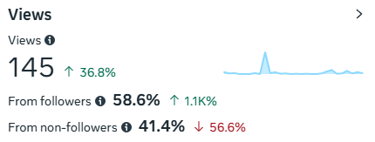
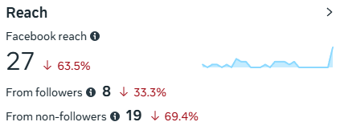
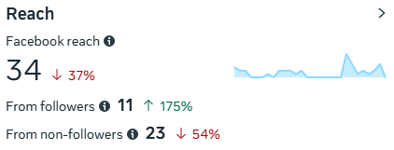
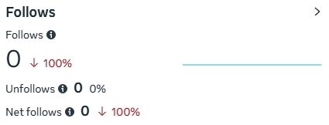
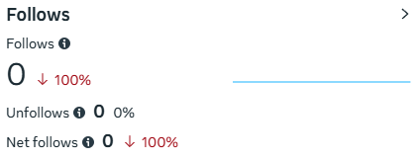
Digital Marketing
Future-X Website
Facebook Insights
Previous Record
Current Week

Slide 4

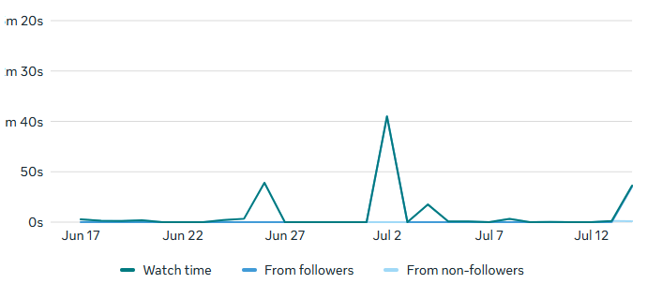
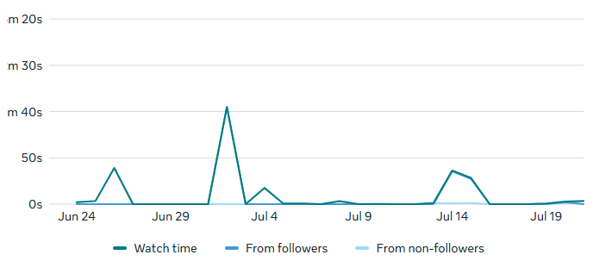
Digital Marketing
Facebook Insights
Previous Record
Current Week

Slide 5

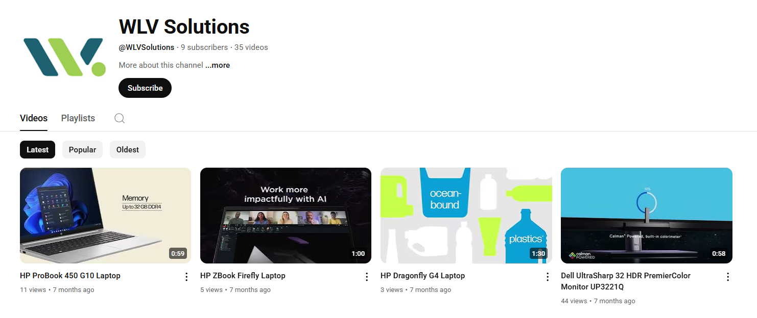
YouTube
https://www.youtube.com/@WLVSolutions

Slide 6
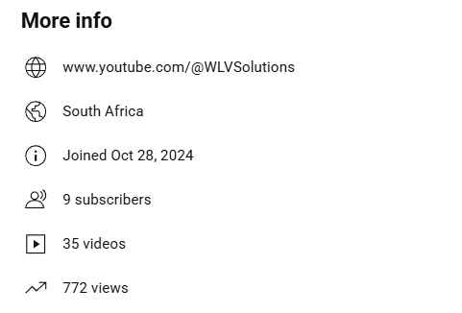
YouTube
YouTube Stats

Slide 7
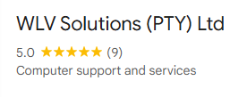
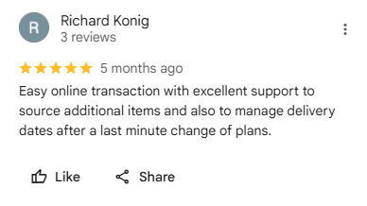
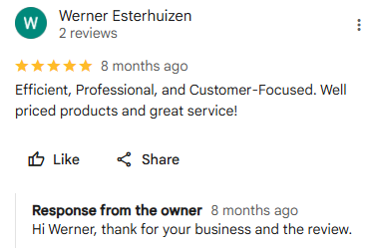
Digital Marketing
Google Reviews
Reviews: 9
All 5-star reviews

Slide 8
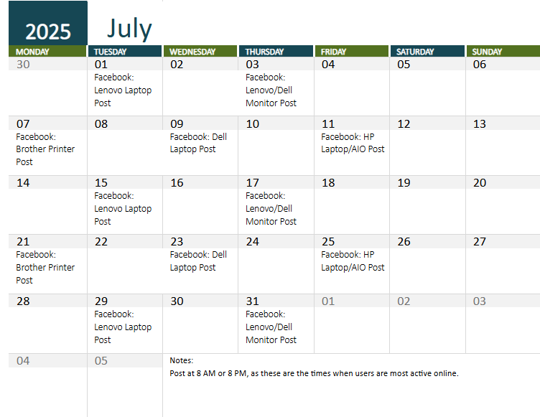
sssssssssss
CALENDAR
Post Schedule for Facebook
Post at 8AM or 8PM.
As these are the times when users are most active online.

Slide 9
Learning
Mailchimp
Sending emails
User journeys
Integrating with wordpress
Backend
Fetching apis
Authentication
Cookies
Vue
Built a todo app
Using CLI
Combining with PHP

Slide 10
Sales / Municipalities
Month | Closing date | Customer | Description | Type Of Sale | Comments
September | 06 September 2024 | Pachedu Skills Solutions (PTY) LTD | Brother Lower Paper Tray Sheets | General Sale | On Back Order
September | 25 September | Marten van Suylekom | Dell U4025QW Monitor | General Sale | On Back Order
November | 08 November 2024 | Mason K General Trading | Printers | General Sale | Quotation Sent
November | 11 November 2024 | Octagon Lynx Trading (Pty) Ltd | Brother Toners | General Sale | Quotation Sent
December | 26 November 2024 | NTP Consulting | Supply and Delivery of Laptop & Power Banks | General Sale | Quotation Sent

Slide 11
Back Orders
ETA Date | Customer | Description | Quote/Invoice | Comments
15 November 2024 | Pachedu Skills Solutions (PTY) LTD | Brother Lower Paper Tray Sheets | Invoice 240168 | Awaiting
15 November 2024 | Marten van Suylekom | Dell U4025QW Monitor | Invoice 240170 | Awaiting

Slide 12

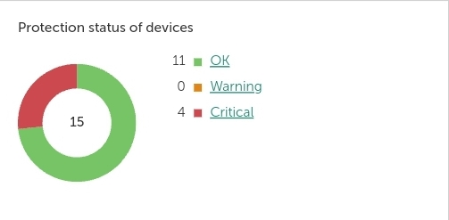
WLV Kaspersky – Security
Previous Week
Current Week
Critical: 4
Andisiwe
Tarry
Wayne (Honor;
Samsung)

Slide 13
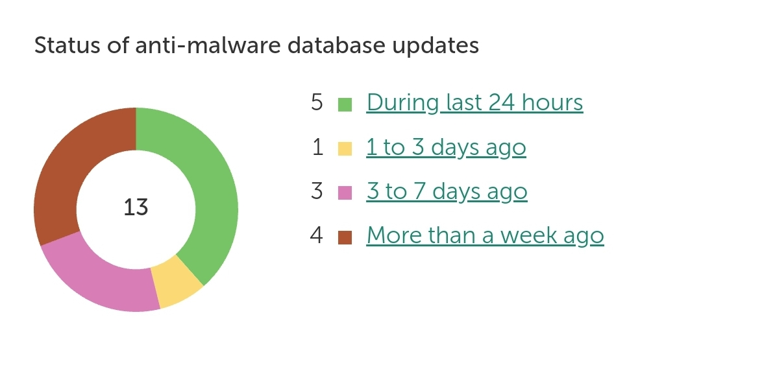
WLV Kaspersky – Security
Devices that have not ran Anti-Malware database scan for over a week: 4
Noluvuyo
Wayne (E490; Honor; Samsung)

Slide 14
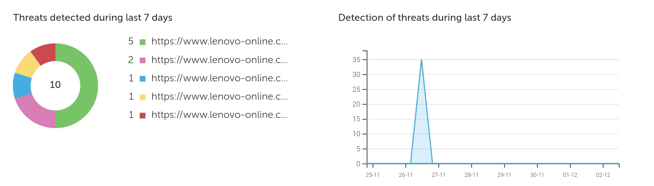
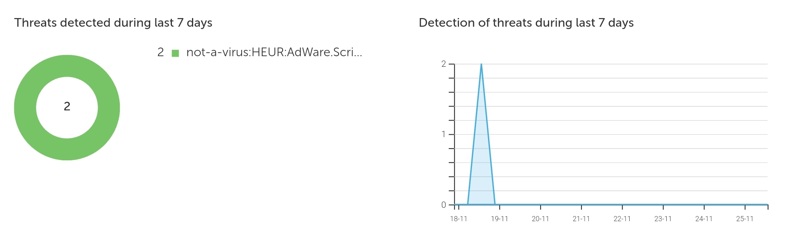
WLV Kaspersky – Security
Current Week
10 threats were detected in the previous week:
Ayavuya - 4
Bonginkosi - 6
Previous Week

Slide 15
WLV Kaspersky – Security
Current Week
10 threats were detected in the previous week:
Ayavuya - 4
Bonginkosi - 6
Previous Week

Slide 16
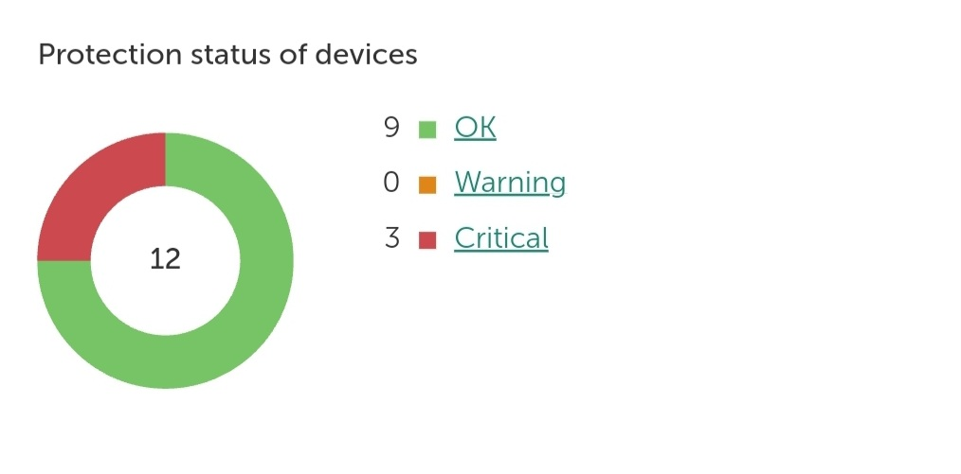
PAED-IQ – Security
PAED-IQ Kaspersky – Security
Previous Week
Current Week
Critical: 3
Fawwaaz (unassigned device)
Fawwaaz (Desktop )
Sonette

Slide 17
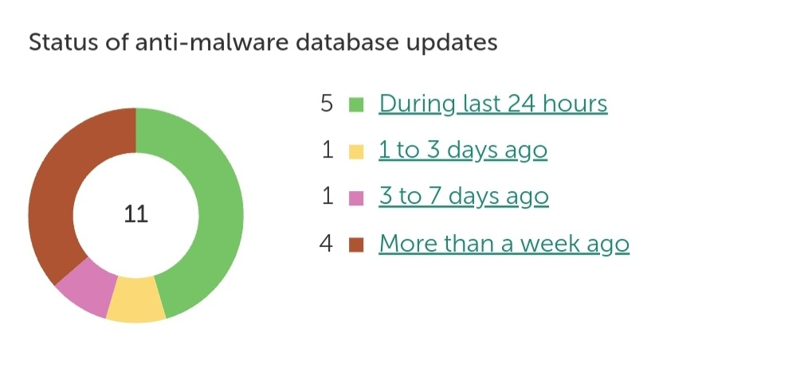
PAED-IQ Kaspersky – Security
There are 4 devices that has not ran Anti-Malware database scan for more than a week:
Fawwaaz
Crystal
Karen
Sonette

Slide 18
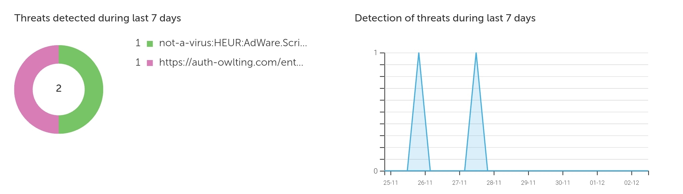
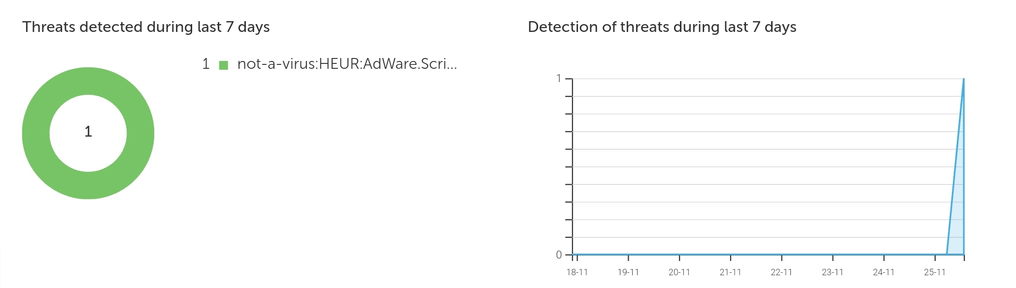
PAED-IQ Kaspersky – Security
Current Week
2 threat were detected in the previous week:
Estelle- 1
Iqbal - 1
Previous Week

Slide 19
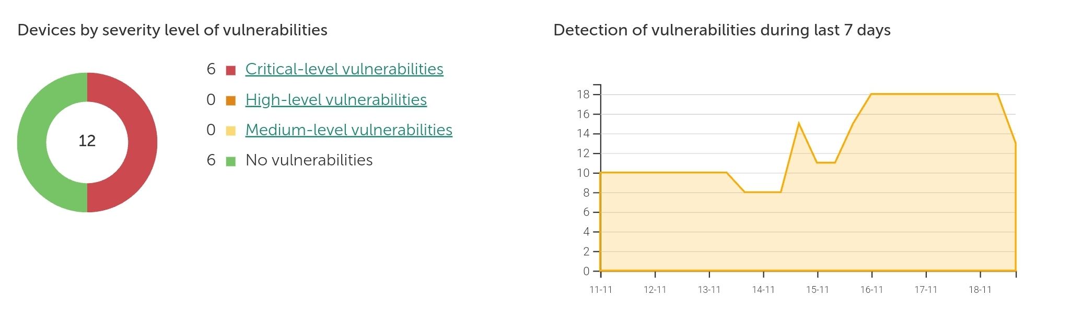
PAED-IQ Kaspersky – Security
Current Week
Critical-level: 6 (Windows Updates)
Fawwaaz (2 divices)
Evelyn
Iqbal
Suzelle
Talia
Previous Week

Slide 20
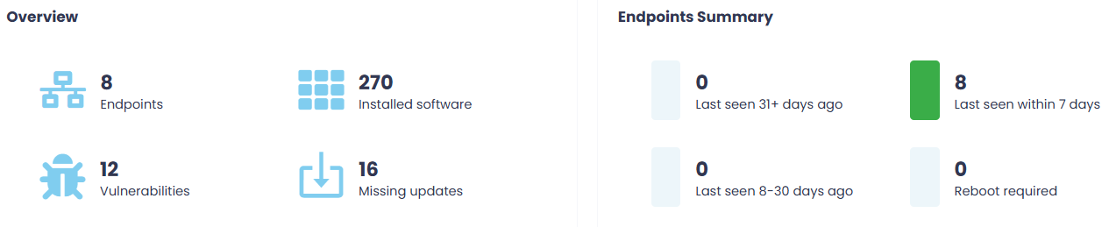
Patch Management – W.L
Two weeks ago updates

Slide 21
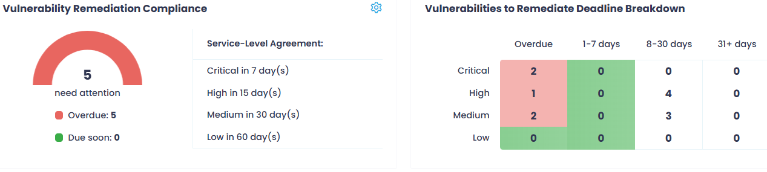
Patch Management – W.L
Two weeks ago updates

Slide 22
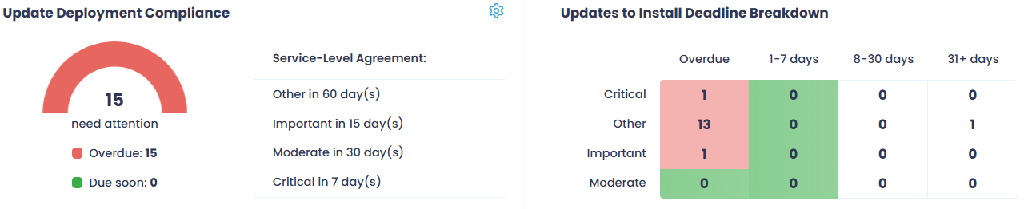
Patch Management – W.L
Two weeks ago updates

Slide 23
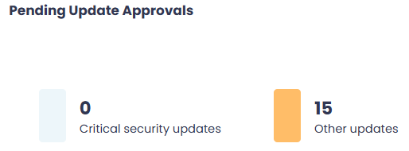
Patch Management – W.L
Two weeks ago updates

Slide 24
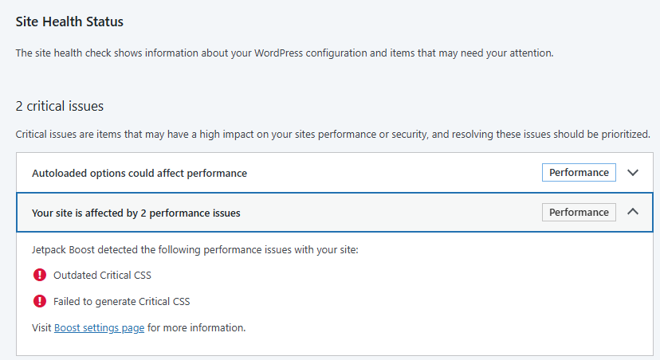
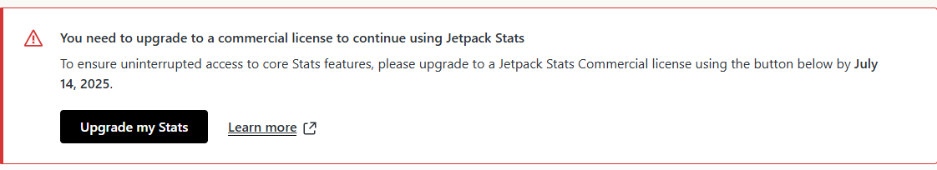
Projects & Developments – Y.N
WLV WEBSITE
Site health almost good
2 critical issues, 8 normal issues.
Jetpack Expired

Slide 25
Projects & Developments – Y.N
WLV WEBSITE
Site health almost good
2 critical issues, 8 normal issues.
Jetpack Expired

Slide 26
Projects & Developments – Y.N
WLV WEBSITE
Site health almost good
2 critical issues, 8 normal issues.
Jetpack Expired

Slide 27
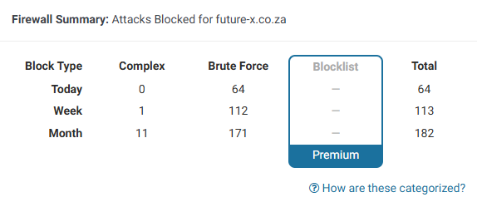
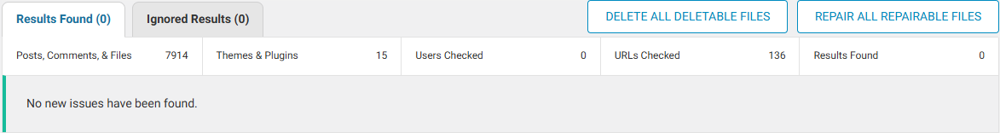
Projects & Developments – A.H
Future-X Website
Backed up websites
WordPress installation up to date
Plugins and themes up to date
Ran vulnerability scans and addressed security risks.

Slide 28
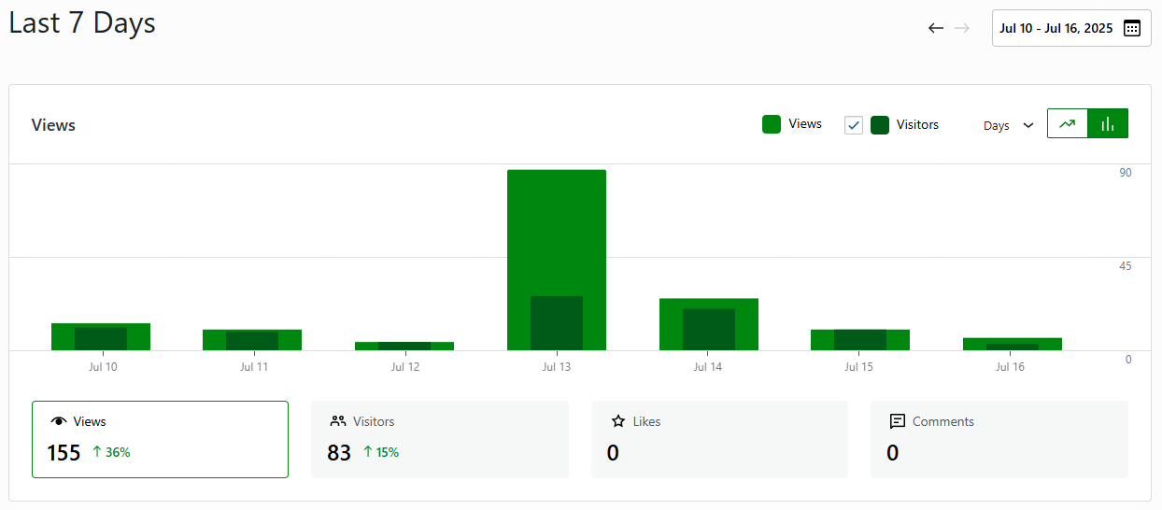
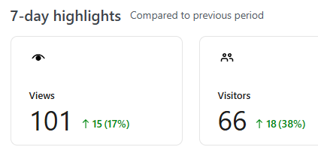
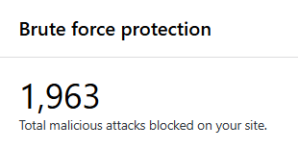

Projects & Developments A.H
Paed-iQ Website
Backed up websites
WordPress installation up to date
Plugins and themes up to date
Ran vulnerability scans and addressed security risks.

Slide 29
Processes
All Policies have been signed off from everyone

Slide 30
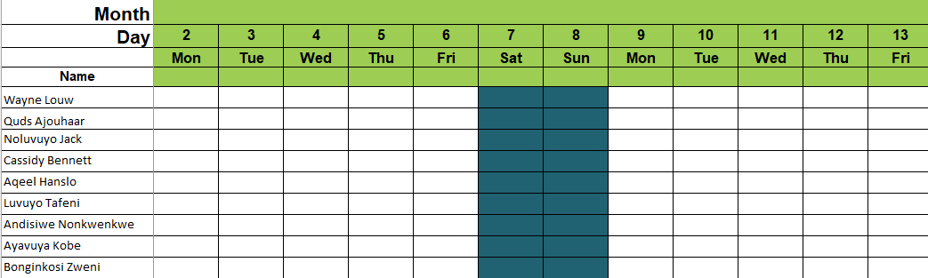
Leave Calendar
December
Business to close on the 20th December 2024 and reopen on the 6th January 2025

Slide 31
/
Action Plan
Nr | Description | Responsible | Status | Due Date | Comment
1 | Reports Kaspersky ( Ayavuya) Statics report – Bonnita ( Luvuyo) Statics report – WLV Website (Luvuyo) Paed – IQ ( Aqeel) | AH, LT, AK | In progress | 3 August
2 | Trackers Sales Tracker InvoiTrackerce | WL, QA | In progress
3 | Digital Sales & Marketing Facebook Shop Google Shop Mailchimp | WL, AH | In progress
4 | Verify all timesheets are updated | QA | In progress | 18 November | Andisiwe, Ayavuya, Bonginkosi and Luvuyo needs to update their timesheets.
Chair Sequence: WL,LT, CB, AH, AN, AK,BZ

Slide 32

QUESTIONS
&
ANSWERS

Slide 33
THANK YOU

